Slide 1
Discussion of
“Double marginalization and vertical integration” by Philippe Choné, Laurent Linnermer & Thibaud Vergé
Marc Bourreau
Telecom Paris, Institut Polytechnique de Paris

Slide 2

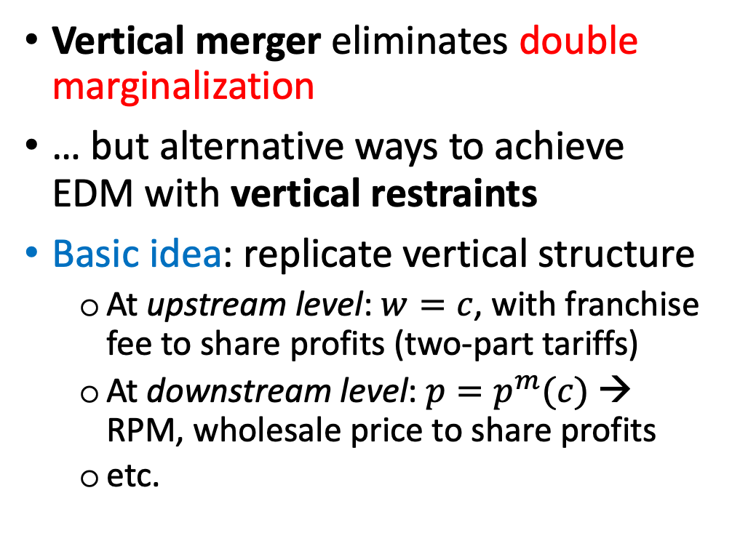


Textbook treatment of double marginalization
$$c$$
Vertical merger eliminates double marginalization
… but alternative ways to achieve EDM with vertical restraints
Basic idea: replicate vertical structure
  At upstream level: $w=c$, with franchise fee to share profits (two-part tariffs)
  At downstream level: $p=p^{m}(c)$ → RPM, wholesale price to share profits
  etc.
Upstream firm
(manufacturer)
$$w>c$$
Downstream firm
(retailer)
$$p=p^{m}(w)>p^{m}(c)$$
Consumers
e.g., Tirole (1988), Motta (2004)…

Slide 3
Merger specificity of EDM
Gains from EDM are merger-specific only if they cannot be achieved by other (less costly) means
In the textbook model on DM, EDM is clearly not merger-specific
  Not a good benchmark to assess EDM in a merger case
Contribution of this paper:
  A model where EDM is merger-specific
  Source of DM: asymmetric information
Additional twist: EDM may also entail (customer) foreclosure
  Possible trade-off btw EDM and foreclosure

Slide 4
Key ingredients for DM to arise in the model
Asymmetric information
  Complete information: with or w/o VI, the most efficient supplier is selected, no DM, suppliers make zero profits, industry profit maximized
  What if the buyer could learn about the suppliers’ costs?
Low bargaining power of suppliers at production stage
  Bargaining weight of supplier that produces must be lower than 1
    If bargaining weight = 1: no DM
  The buyer tends to purchase from the supplier with the strongest bargaining power → DM vanishes with entry/more competition (presence of entry barriers matters)

Slide 5
EDM and customer foreclosure
EDM and customer foreclosure are intertwined
  VI => EDM if the buyer supplies internally
  VI => higher probability that the acquired supplier produces => lower profit for outside suppliers
  The integrated supplier may be less efficient than an independent supplier but still selected due to EDM!
Note: EDM is more than a pecuniary externality in this model; it also affects directly the buyer’s efficiency at the production stage → “real” economies or diseconomies (Kwoka & Slade, 2020)

Slide 6
Merger specificity
EDM is merger-specific as long as you do not find any other (less costly) means to achieve it?
Merger-specificity wrt two-part tariffs; but what about other means?
What about the suppliers and buyers coordinating on the design of the procurement?
  For example, decide jointly to set weights of suppliers to 1: EDM?
What about the buyer stimulating entry upstream to reduce DM?

Slide 7
Other comments
Bargaining power & market structure?
  Relation btw upstream market structure and bargaining power of suppliers?
  Effect of vertical merger on bargaining power of independent suppliers?
Free-entry equilibrium in this environment?
  Suppliers that are not selected or do not produce: do they remain in the market? Exit the market?

